Slide 1
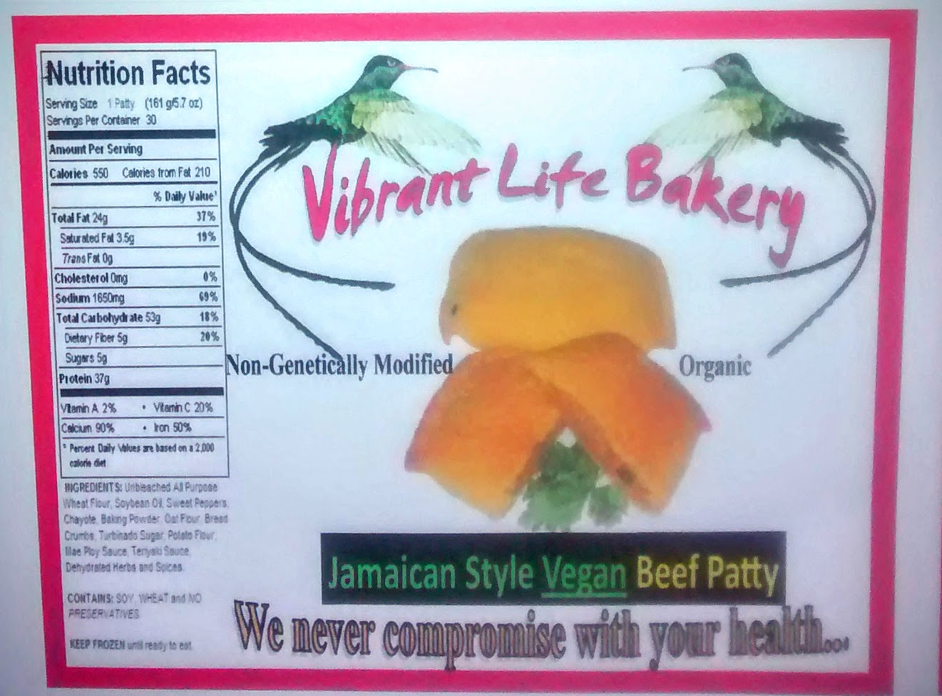

Slide 2
OUR MOTTO:
WE NEVER
COMPROMISE
WITH
YOUR HEALTH!

Slide 3
To Perform This…
We work with the “Organic Consumer Association” which certifies companies that uses only Non- Genetically Modified Organism (GMO) in their food.
Our products contain NO MSG
Our products contain NO MODIFIED FOOD STARCH
Our products contain NO FOOD COLORS or DYES
Our products contain NO REFINED SUGAR
We only use Non Genetically Modified (GMO) foods and ingredients
We only use Organic and Certified Foods
We only use Farmers Market vegetables and fruits

Slide 4
Our Product Line Includes:
12 Varieties of Vegetarian Jamaican Patties…
Veggie Beef Patty Spicy Chicken Patty
Veggie Fish Patty Vegetable Patty
Stir Fry Patty Cabbage Patty
Spinach Patty Tofu Patty
Ackee Patty Callaloo Patty
Lentil Patty Bulgar Patty
7 Varieties of Vegetarian Jamaican Fruit Patties:
Squash Patty Chayote Patty
String Bean Patty Eggplant Patty
Papaya Patty Tomato Patty
Cucumber Patty

Slide 5
Let’s examine
just a few of our products
and
compare the nutritional value
and
health benefits
of the
already marketed products.

Slide 7
Vibrant Life Bakery “Veggie Beef Patty” Nutritional Value:
Why Is our Vegetarian Beef Patty better?
Marketed
Jamaican Beef Patty vs Veggie Beef Patty
Ground Beef Meatless Non GMO Soy Beef
Margarine Farmers Market Chayote
Shortening Herbs and Seasonings
Egg
Beef Broth
Herbs
Calories 360 Calories 80
Fat 19G Fat 1.5g
Sodium 450mg Sodium 230mg
Carbohydrates 36g Carbohydrate 5g
Dietary Fiber 1.2% Dietary Fiber 3g
Cholesterol 20mg Calcium 6%
Vitamin C 4% Iron 10%
Calcium 2% Protein 12g
Iron 15%
Protein 11g

Slide 8
Healthful Benefits of Eating Chayote and Meatless Beef Product
Farmer’s Market Chayote
Cholesterol fighter Aids Electrolytes Aids DNA Cancer Aging
It has low calories. High in antioxidants, dietary fiber, vitamins and minerals.
There are high amounts of Potassium and Vitamin C in which the body
needs and the other essentials that Chayote contains which the body
needs is Magnesium, Vitamin B6, and Iron.
Meatless Non-GMO Soy Beef Product
First of all, it is a Gluten-free product.
Secondly, it contains only 80 calories when animal beef contains 84% more fat.
It’s Fat content is only 1.5g
It’s Sodium is 230mg
The Carbohydrate is 5g.
And the is Protein 12g.
Lastly, it’s delicious!

Slide 9
Healthful Benefits of Eating Garlic, Onion and Peppers
Farmer’s Market Garlic
Garlic is one of the richest sources of organic selenium and germanium.
Ear Infections Cholera Typhus
Blood Pressure Improves Circulation Lowers Blood Sugar
An Antibiotic Acting on Bacteria Viruses
Disinfect Wounds Curing a cold Asthma
High cholesterol Antioxidant Parasites
Sore Throat Cold Sore Mouth Ulcer
Insect Stings and Bites Cancer
Reduce the Build-up of Fatty Deposits in the Arteries
2 cloves of garlic per day are good for the Immune System

Slide 10
Farmer’s Market Onion
Bronchitis Arthritis Asthma
Antibiotic Cancer Diabetes
Wrinkles Skin Infection Burns
Wounds Blood Clots Gout
Kidney Problems Obesity Acne

Slide 11
Organic Peppers
Anti-bacterial Cancer Diabetes
Cholesterol Antioxidant Scurvy
Immune System
Maintains Blood Vessels, Skin, Organs, and Bones.

Slide 12
Vibrant Life Bakery “Spinach Patty” Nutritional Value:
Why is our Spinach Patty better?
Marketed
Spinach(Callaloo)Patty vs Veggie Spinach(Callaloo)Patty
Callaloo Spinach
Onion Organic Carrots
Tomato Meatless Non-GMO Soy Beef
Pepper Onion
Butter Soy Oil
Seasoning Herbs & Seasonings
Calories 293 Calories 7 Folate 226mcg
Fat 13g Fat 0.12g Vitamin 580mcg
Sodium 5mg Sodium 24mg Vitamin E 4.5mg
Carbohydrate 35g Potassium 167mg Phosphorus 76.4mg
Protein 6g Protein 0.86g Magnesium 117mg
Sugar 10g Sugar 0.13g Potassium 540mg
Vitamin A 0% Vitamin A 56%
Vitamin C 1% Vitamin C 14%
Calcium 1% Calcium 3%
Iron 2% Iron 4%

Slide 13
Healthful Benefits of Eating Spinach, Carrots and Soy Oil
Spinach
Skin Hair Bones
Cancer Antioxidants Cholesterol
Colon Brain High Blood Pressure
Asthma Arthritis Migraine Headaches
Inflammation Eye Disease Blood Cells
Organic Carrots
Skin Cancer Anti-aging
Vision Prevents Infection Heart Disease
Liver Cleanser Toxins Teeth and Gums
Stroke
Soy Oil or Sunflower Oil
Antioxidants Omega 3 Fatty Acids Vitamin E

Slide 14
Vibrant Life Bakery “Cabbage Patty” Nutritional Value:
Both Products Contains Healthful Ingredients:
Marketed
Jamaican Cabbage Patty vs Cabbage Patty
Cabbage Cabbage
Carrots Organic Carrots
Corn Non-GMO Tofu
Green Peas Bread Crumbs
Potatoes Onion
Garlic Soy Oil
Lemon Juice Herbs and Seasonings
Coconut Oil
Herbs and Seasonings
Cabbage and Carrots Contains: Calories 74% Vitamin K Tofu Contains: Calories 183
Fat 0 Folate 38.3 Fat 11g
Cholesterol 0 Magnesium 10.7 Sodium 18g
Sodium 106mg Phosphorus 23.1 Dietary Fiber 3g
Carbohydrate 17g Protein 20g Vitamin A 4%
Dietary Fiber 6g Protein 20%
Sugar 9g Calcium 86%
Protein 2g
Vitamin A 430%
Vitamin C 67%
Iron 19%

Slide 15
Healthful Benefits of Eating Cabbage and Tofu
Farmer’s Market Cabbage
Cancer Constipation Ulcers
Headaches Obesity Skin Disorder
Eczema Jaundice Scurvy
Rheumatism Arthritis Gout
Eye Disorders Heart Diseases Aging
Alzheimer’s Disease Bleeding Gums Cracked Lip Corners
Immune System Cold Depression
Antioxidants Wounds Damaged Tissue
Nervous System Weight Loss
Non-GMO Tofu
Cancer Antioxidant Heart Disease
Low Blood Pressure Inflammation Cholesterol
Obesity

Slide 16
Vibrant Life Bakery Pot Pies

Slide 17
#2 Varieties of Vegetarian Pot Pies:
Vegetable Pot Pie
Fruit Pot Pie

Slide 18
Vibrant Life Bakery “Vegetable Pot Pie” Nutritional Value
Why is our Vegetable Pot Pie is better?
Marketed vs Vegetable Pot Pie
Vegetable Pot Pie
Potato Carrot
Carrot Potato
Pea Broccoli
Corn Non-Dairy Cream Cheese
Asparagus Herbs and Seasonings
Leek Whole Wheat Flour
Mushroom Sea Salt
Cashew Butter Sunflower Oil
Whole Wheat Flour Nuts
Garlic
Vegetable Broth
Oil Olive
Soy Margarine
Calories 244 Sugar 5g Calories 238 Vitamin A
Protein 6g Vitamin C Fat 0.10 Vitamin C
Fat 10g Vitamin K Sodium 104mg Vitamin K
Carbohydrate 35g Vitamin B6 Carbohydrate 53g Vitamin B6
Sodium 207mg Vitamin 8 Dietary Fiber 10.2g Vitamin 8
Dietary Fiber 4g Iron Sugar 7.1g Potassium
Vitamin A Folate Iron Folate

Slide 19
Healthful Benefits of Eating Carrots, Potatoes and Broccoli
Broccoli
Cancer Cholesterol Allergies
Inflammation Antioxidants Bone
Heart Diet
Carrot
Antioxidant Skin Saliva
Digestion Heart Vision
Cancer Reduce Aging Immune System
Detoxify the Body Teeth Blood Pressure
Potato
Digestion Cholesterol Immune System
Polyps Cancer Diabetes
Reduce Aging Circulation Fluid Balance
Insomnia Skin Vision

Slide 20
Vibrant Life Bakery “Fruit Pot Pie” Nutritional Value
Why is our Fruit Pot Pie is better?
Marketed Tomato Pot Pie vs Fruit Pot Pie
There is none Organic Tomato
Chayote
Squash
Bell Pepper
Non-Dairy Cheese
Herbs and Seasonings
Calories 22
Fat 0.6g
Sodium 6mg
Potassium 292mg
Carbohydrate 4.8g
Vitamin 20 %
Vitamin C 28%
Vitamin B6 5%
Magnesium 3%

Slide 21
Healthful Benefits of Eating Tomatoes and Squash
Tomato
Antioxidant Bone Liver
Kidneys Blood Vessels Heart
Cancer Alzheimer's
Squash
Eyes Skin Immune System
Diabetes Bone Heart
Insomnia Inflammation Arthritis
Ulcers Parasites Infections
Birth Defects Respiratory Blood Pressure
Aids in Emphysema Lung Cancer

Slide 22
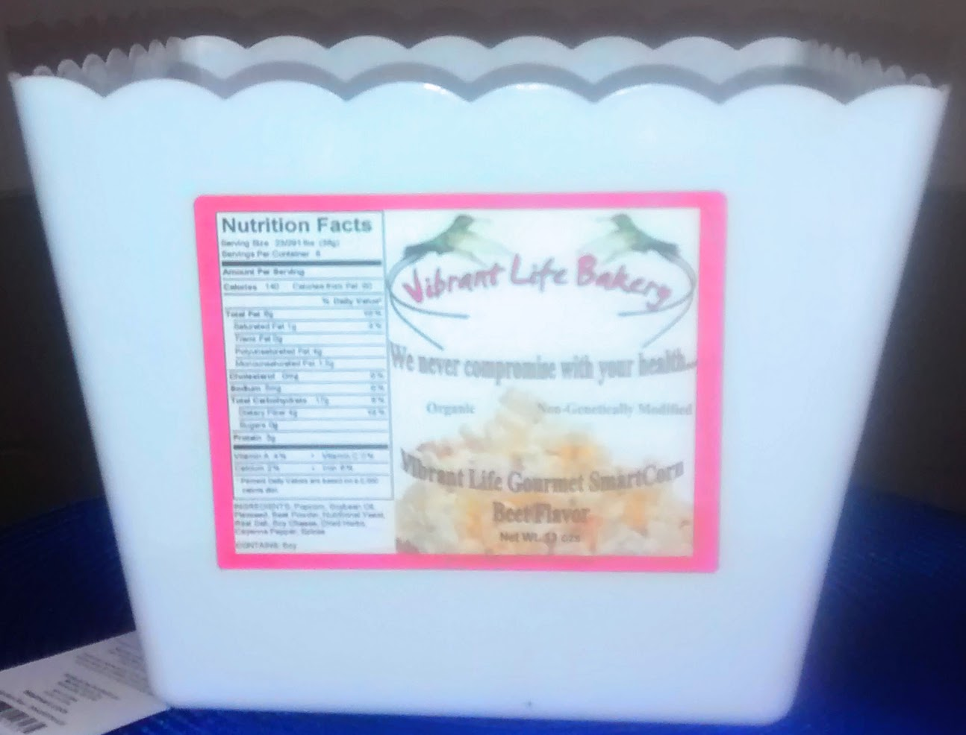

Slide 23
# 3 Varieties of Popcorn
Herbal Seasoned Popcorn
Hot & Spicy Popcorn
Energized Beet Popcorn

Slide 24
Health Benefits of Vibrant Life Bakery “Herbal Seasoned” Popcorn
Why is our Herbal Seasoning Popcorn better?
Orville Redenbacher's Natural Popcorn vs. Herbal Seasoned Popcorn
Corn Kernels Non-GMO Corn Kernels
Salt Sea Salt
Butter Sunflower Oil
Herbs
Calories 170 Calories 190
Fat 11g Fat 1.5g
Sodium 400 Sodium 0.5g
Potassium 37mg
Vibrant Life uses only Organic Non-GMO corn kernels, no butter and healthy
herbs and Seasonings to give the popcorn its flavor.

Slide 25
The Health Benefits of Eating Vibrant Life Bakery “Herbal Seasoned” Popcorn
23 Amino Acids 20 Vitamins & Minerals
No Blood Pressure Digestion Diabetes
Bone Immune System Eyes
Arthritis Menstrual Problems Kidneys
Nervous System Cancer Omega 3
Liver No Cholesterol Blood
Relieves Constipation

Slide 26
THE END

Slide 29
# Variety of Entrees:
Oatmeal Patties
Meatless Barbeque Ribs
Dairy Free Macaroni and Cheese
Whole Wheat Vegetable Lasagna
Whole Wheat Fruit Lasagna

Slide 30
Health Benefits of the Ingredients:

Slide 31
# Variety of Dairy Free Cheese Sauces:
Cheddar Cheese Sauce
Monterey Cheese Sauce
Cashew Cheese Sauce
Olive Cheese Sauce

Slide 32
Health Benefits of the Ingredients:

Slide 33
Breakfast Entrees:
Granola Cereal

Slide 34
Health Benefits of the Ingredients:

Slide 35
# Variety of Breads:
Corn Bread
Raisin Bread
Whole Wheat Oatmeal Bread
Whole Wheat Dinner Rolls
Diabetic Bread

Slide 36
Health Benefits of the Ingredients:

Slide 37
muffins
blueberry

Slide 38
Ingreints and health benefits

Slide 39
biscuits

Slide 40
Ingrdients and health benefits

Slide 41
Split Pea and Butternut Squash Soups
Split

Slide 42
Health Benefits of the Ingredients:

Slide 43
Dairy Free Cakes
Carrot Cake
Blueberry Pineapple Cake
Carob Cake

Slide 44
Ingredients and health benefits

Slide 45
# Variety of Healthy Cookies:
Oatmeal Cookies (with nuts)
Maple Cookies (with nuts)

Slide 46
Ingredient and health benefits

Slide 47
Dessert Topping:
Vanilla Cream Topping

Slide 48
Health Benefits of the Ingredients:

Slide 49
Royainaise

Slide 50
Vibrant Life “Spicy Chicken Patty” Nutritional Value:
Why is Our Chicken Patty Better?
Marketed Jamaican
Chicken Patty vs Spicy Chicken Patty
Chicken Meatless Non-GMO Soy Chicken
Onion Onion
Garlic Organic Green Pepper
Bread Crumbs Bread Crumbs
Chicken Bouillon Garlic
Parsley Chayote
Seasonings
Calories 360 Calories 120
Fat 17g Fat 5g
Cholesterol 35mg Cholesterol 0
Sodium 430mg Sodium 260 mg
Carbohydrates 40g Carbohydrates 4 mg
Protein 12g Protein 15g
Vitamin A 4% Calcium 2%
Calcium 6% Iron 10%
Iron 6%

Slide 51
Vibrant Life “Classic Eggplant Patty” Nutritional Value:
Why is Our Eggplant Patty Better?
There is no vs Classic Eggplant Patty
marketed Farmer’s Market Eggplant
product Organic Bell Pepper
that exist Organic Tomato
Farmer’s Market Chayote
Farmer’s Market Onion
Non-Dairy Soy Cheese
Eggplant Chayote Tomato Bell Pepper
Calories 33 Calories 25 Calories 22 Calories 30
Sodium 237mg Sodium 3mg Sodium 6mg Sodium 4mg
Carbohydrate 2g Carbohydrate 6g Potassium 292mg Carbohydrate 7g
Thiamin 5% Potassium 165mg Carbohydrate 2.8g Vitamin A 11%
Vitamin B6 4% Dietary Fiber 2.2g Vitamin A 20% Vitamin c 22%
Vitamin K 4% Protein 1.1g Vitamin C 28% Iron 3%
Vitamin C 17% Vitamin B6 12% Calcium 1%
Vitamin B6 5% Magnesium 3%
Magnesium 4% Iron 1%
Iron 2% Calcium 1%
Calcium 2%

Slide 52
Vibrant Life “Vegetarian Chicken Pot Pie” Nutritional Value
Why Vibrant Life Chicken Pot Pie is Better?
Marketed Chicken Pot Pie vs Veggie Chicken Pot Pie
Chicken Meatless Non-GMO Soy Chicken
Potato Farmer’s Market Acorn Sqaush
Peas Farmer’s Market Chayote
Carrots Organic Carrots
Chicken Broth Non-Dairy Soy Cheese
Chicken Fat Farmer’s Market Onion
Whey
Salt
Calories 400 Calories 291
Fat 21g Fat 12g
Cholesterol 35mg Cholesterol 0
Sodium 780mg Sodium 264mg
Carbohydrate 36g Carbohydrate 22mg
Protein 11g Protein 17g
Potassium 170mg Potassium 195mg
Vitamin A 25% Vitamin A 213%
Vitamin C 4% Vitamin C 32%
Iron 4% Iron 6%
Calcium 4% Calcium 7%
Phophorus 15% Vitamin B6 6%
Magnesium 1%

Slide 53
Healthful Benefits of Eating Squash
Farmer’s Market Squash
Immune System Cancer Vision
Skin Bones Blood Pressure
Maintain Fluid Balance Regulate Blood Sugar Cholesterol
Digestion Circulation Muscle Tissue
Blood Vessels Teeth Organs
Antioxidant Heart Disease Wounds
Constipation Diarrhea Cramping
Bloating Diabetes
Atherosclerosis Strokes

Slide 54
Healthful Benefits of Eating Eggplant, Tomato and Non-Dairy Cheese
Farmer’s Market Eggplant
Blood Circulation Colon Cancer Diabetes
Heart Disease Cholesterol Stress
High Blood Pressure Blood Clots
Diary Cheese vs Non-Dairy Soy Cheese
Calories 532 Calories 90
Fat 44g Fat 6g
Cholesterol 139mg Cholesterol 0
Sodium 820mg Sodium 250mg
Protein 33g Protein 1g

